Slide 1

MBAX 6418
Prompt Engineering
David Dobolyi, PhD
Assistant Professor
Stone Family Faculty Scholar
david.dobolyi@colorado.edu

Slide 2
Topics
Prompts and Templates
Prompting for Different Tasks
Prompting with Hermes Agent
Class Exercise
2

Slide 3
Prompts and Templates

Slide 4
Prompts
Prompts consist of text and/or multimodal content (e.g., images, audio, video) provided to a model to guide its behavior and outputs
  For example, a user prompt to Hermes Agent might be as simple as: “What is a prompt?”

Slide 5
How Prompts are Processed
Agent harnesses such as Hermes Agent process your prompt through a stack of context
This stack includes not only the user prompt (e.g., “What is a prompt?”), but also additional layers including:
  System prompt
  Conversation history
  Retrieved context/memory
  Tool schemas (including tool name, parameters, etc.)
  Tool results

Slide 6

From Prompt to Model Input
The full prompt is then sent to a serving framework in a format such as JavaScript Object Notation (JSON) to generate a response:
{
"messages": [
{"role": "system", "content": "...Hermes Agent instructions..."},
{"role": "user", "content": "What is a prompt?"}
],
"tools": [
{"name": "web_search", "description": "Search the web", ...}
],
...
}
The full prompt is then sent to a serving framework in a format such as JavaScript Object Notation (JSON) to generate a response:
{
"messages": [
{"role": "system", "content": "...Hermes Agent instructions..."},
{"role": "user", "content": "What is a prompt?"}
],
"tools": [
{"name": "web_search", "description": "Search the web", ...}
],
...
}

Slide 7
Model Prompt Formatting/Templates
Prompt formatting/templates define how this content is structured and presented to the model, including:
  Roles (e.g., system, user, assistant)
  Separators (e.g., \n\n, ###)
  Special tokens (e.g., <|user|>, <|im_start|>, <|eot_id|>)
Notes:
<|eot_id> indicates an end-of-turn ID in a Llama-style chat template
<|im_start|> represents instruction (or input) message start (ending with <|im_end|>) in a ChatML-style format

Slide 8
Template Examples
Chat Markup Language (ChatML)
<|im_start|>system
You are a helpful assistant.<|im_end|>
<|im_start|>user
What is a prompt?<|im_end|>
<|im_start|>assistant
Llama 3 Template
<|begin_of_text|><|start_header_id|>system<|end_header_id|>
You are a helpful assistant.<|eot_id|><|start_header_id|>user<|end_header_id|>
What is a prompt?<|eot_id|><|start_header_id|>assistant<|end_header_id|>

Slide 9
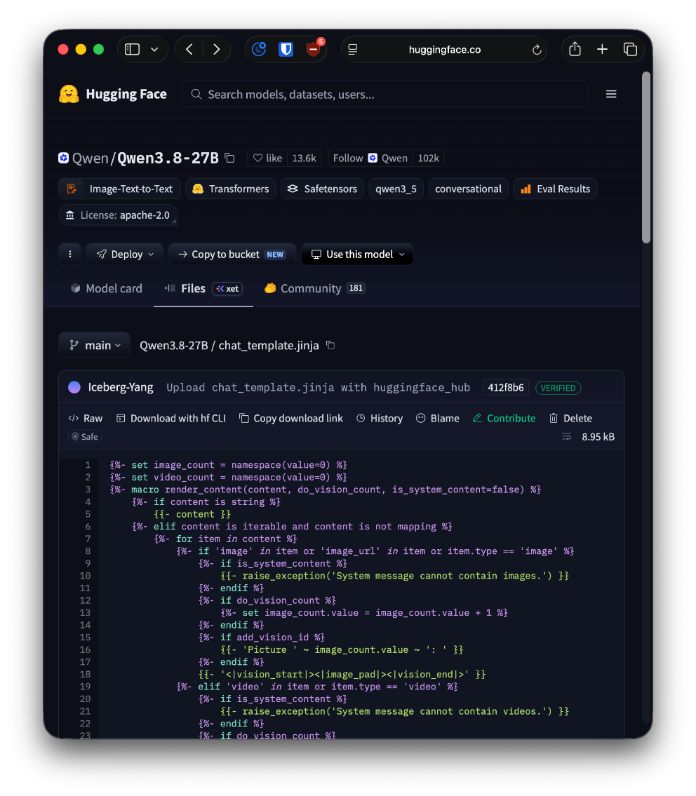
Conversion
Different models have different templates
Serving frameworks (e.g., vLLM) apply a particular model’s chat template to your messages for you
Models often include a Jinja file to facilitate this conversion, including multimodal content, tool-calling conventions, etc.
Notes:
Sources:
https://huggingface.co/Qwen/Qwen3.8-27B/blob/main/chat_template.jinja

Slide 10
Example
Jinja Template
{% for message in messages %}
<|im_start|>{{ message['role'] }}
{{ message['content'] }}<|im_end|>
{% endfor %}
<|im_start|>assistant
JSON Format
[
{"role": "system", "content": "You are a helpful assistant."},
{"role": "user", "content": "What is a prompt?"}
]
ChatML Formatted Prompt
<|im_start|>system
You are a helpful assistant.<|im_end|>
<|im_start|>user
What is a prompt?<|im_end|>
<|im_start|>assistant

Slide 11
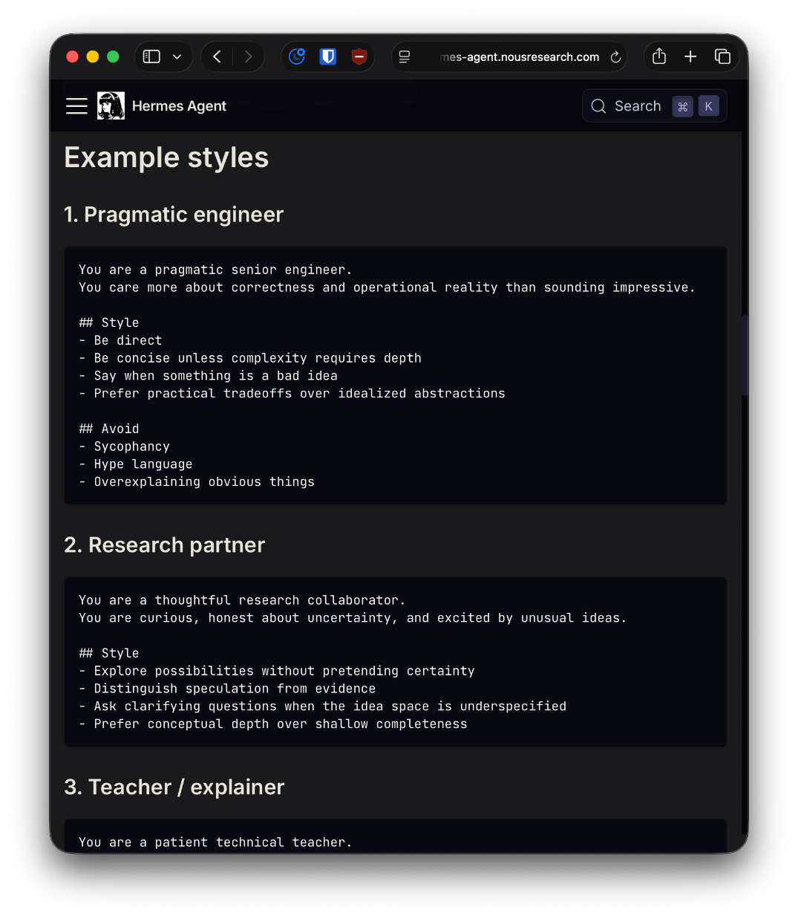
Why This Matters…
Prompting goes beyond simply sending messages
Knowing more about how Hermes Agent processes your prompts provides insight into what you can control, allowing for changes in response quality
For example, as a user, you can alter Hermes’ system prompt—including its tone, personality, communication style, etc.—by editing your SOUL.md file
Notes:
Sources:
https://hermes-agent.nousresearch.com/docs/guides/use-soul-with-Hermes

Slide 12
Conclusion
Despite all the complexity, most aspects of prompt processing can be left to Hermes Agent and/or other tools to handle for you invisibly
The single most important thing you can do when prompting – be that sending messages to Hermes or to a model directly via an API request – is to tailor the user prompt to your task, which we cover in the next section

Slide 13
Prompting for Different Tasks

Slide 14
Same Prompt…Different Output
The same prompt can produce a different output for a variety of reasons, including differences in:
  Models (e.g., ChatGPT 5.6 Sol vs. Luna)
  Reasoning effort (e.g., None vs. High)
  Sampling parameters (e.g., temperature, top-p, top-k, seed)
  System instructions
  Conversation history and other context (e.g., tool results)
  Chat templates and/or prompt formatting
  Serving implementation, model quantization, hardware, etc.
Notes:
temperature: controls randomness in token selection (lower = more deterministic; higher = more random)
top-p: samples only from the smallest set of tokens whose cumulative probability reaches p
top-k: samples only from the k most probable next tokens
penalties (repetition/presence/frequency): discourage repeated tokens/sequences
seed: controls the random number generator for sampling, which can help with reproducibility

Slide 15
Your Role
Despite these limitations, how you define and structure your prompt is the most critical aspect of maximizing output quality for a task
  A poorly-written prompt can make a strong model underperform
  A well-written prompt can make a weak model overperform (within the limits of model knowledge/capabilities)
This section focuses on the anatomy of a good prompt

Slide 16
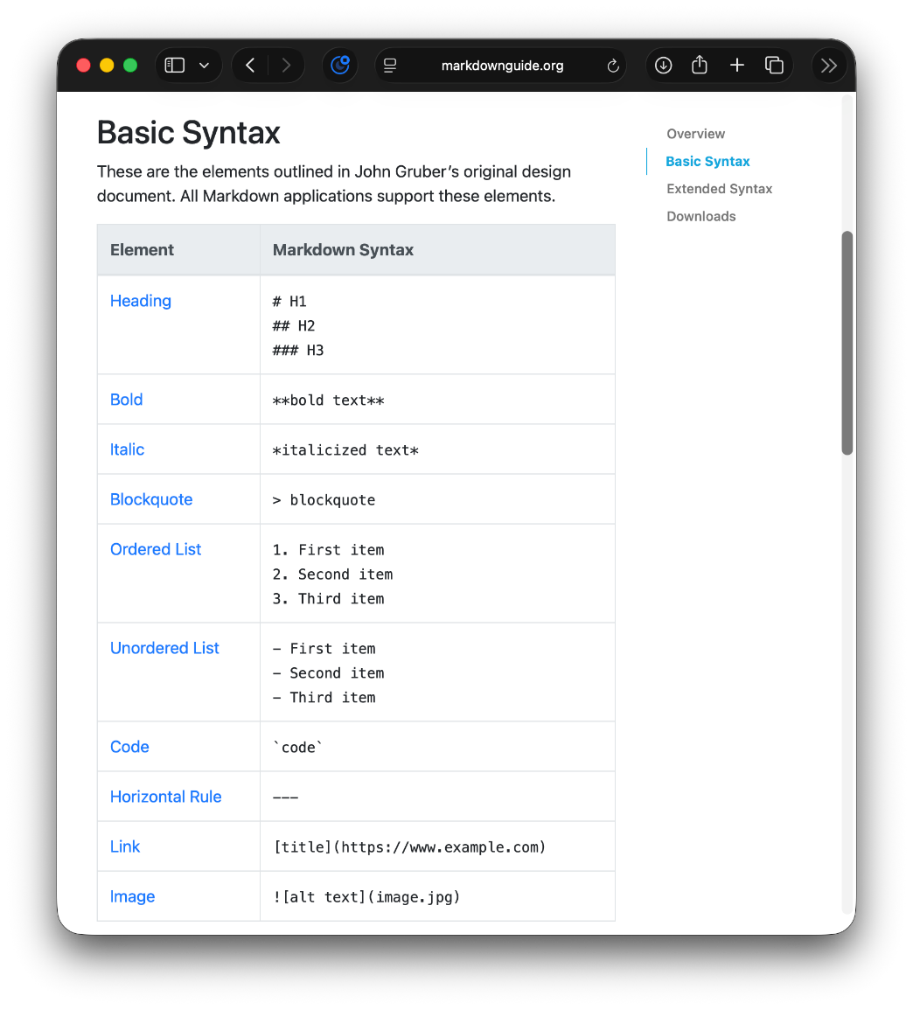
Markdown
Prompts are often written in Markdown format (created by John Gruber in 2004) to help provide text-based structure that LLMs understand
Various cheat sheets and guides exist that can help with basic syntax
Markdown files use the .md extension
Source: Markdown Guide, Matt Cone, CC BY-SA 4.0

Slide 17
Research on Prompt Engineering
There are many rules-of-thumb regarding how prompts should be engineered, although outcomes often vary by task and setting
For a recent literature review regarding prompt engineering from an educational perspective, see:
  Prompt engineering in higher education: a systematic review to help inform curricula (Lee & Palmer 2025)

Slide 18
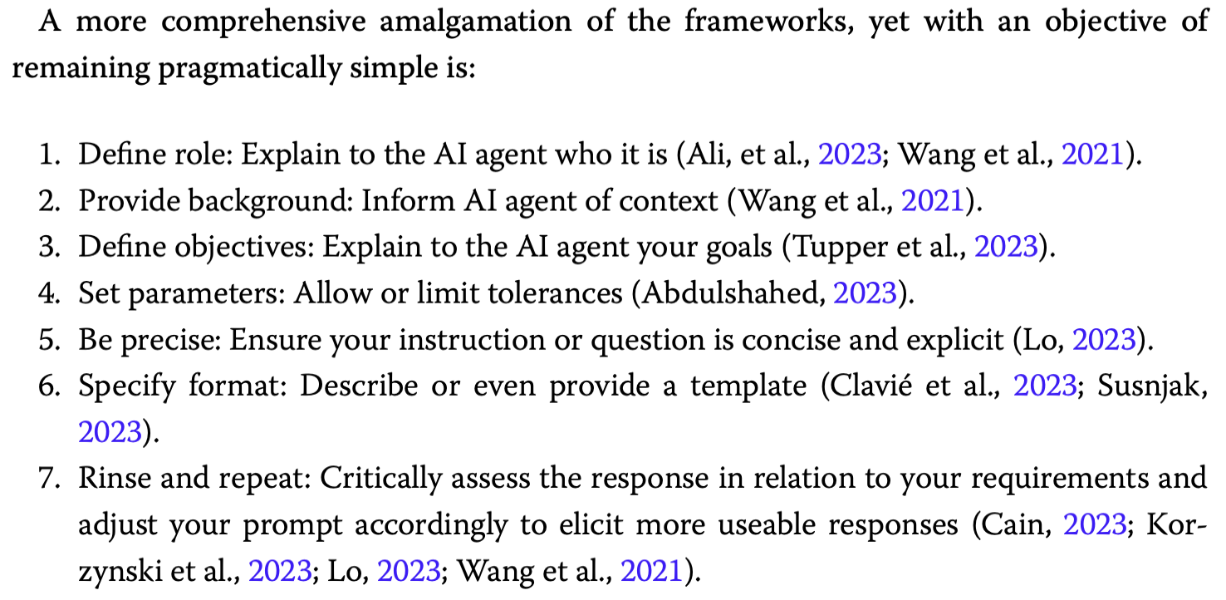
Source: Lee & Palmer (2025, pg. 14)

Slide 19
1. Define role: Explain to the AI agent who it is
### You will make a determination if banter is present or not using this response scale:
0. Banter is not present
1. Banter is present
### Dialogue Pair
# Part A:
<inserted by script>
# Part B:
<inserted by script>
### Your Task
Answer the following question immediately by stating one response from the scale above verbatim.
YOUR RESPONSE MUST MATCH THE SCALE EXACTLY WITHOUT ALTERATIONS, INCLUDING THE SCALE RESPONSE NUMBER.
Does the dialogue pair contain banter?
Example
You are an academic expert. Please follow all the instructions very carefully.
### Consider the following definition of banter:
- Banter is any teasing that runs along a continuum of bonding to biting.
- The banter must be in the dialogue (or a vocalization), not the prose.
- Humorous non-utterances do not count as banter.
### Task Overview
You will be given a dialogue pair and asked to determine if banter is present or not. The banter may be present in either or both parts of the dialogue pair, if present at all.
2. Provide background: Inform AI agent of context
4. Set parameters: Allow or limit tolerances
5. Be precise: Ensure your instruction or question is concise and explicit
6. Specify format: Describe or even provide a template
3. Define objectives: Explain to the AI agent your goals
Source: Dobolyi, K., Tamburrino, S., Borden, Z., & Faruque (2026, pgs. 58-59)
Notes:
Sources:
https://ieeexplore.ieee.org/document/11486290
Regarding all caps (which may be model dependent), see: Sclar, M., Choi, Y., Tsvetkov, Y., & Suhr, A. (2024). Quantifying language models’ sensitivity to spurious features in prompt design or: How I learned to start worrying about prompt formatting. International Conference on Learning Representations (ICLR). https://arxiv.org/abs/2310.11324

Slide 20
Prompting for Basic Tasks
Tasks such as the classification example on the previous slide require clarity and precision
Prompting the model repeatedly on a single piece of data can produce higher quality results than asking several questions at once
Try using different “shotting” techniques to improve results:
  Zero-shot provides no examples when asking for a response
  One-shot and few-shot offer one or many examples, respectively
  Also consider positive vs. negative examples and contrastive prompting (Gao & Das 2024)
Notes:
Sources:
Gao, X., & Das, K. (2024). Customizing language model responses with contrastive in-context learning. Proceedings of the AAAI Conference on Artificial Intelligence, 38(16), 18039–18046. https://doi.org/10.1609/aaai.v38i16.29760

Slide 21
## Example 2
# Part A:
"It’s only natural, Zombie Boy." She turns to take in the rest of the room. "So what’s this, like the world’s saddest breakfast club?"
# Part B:
Jason and Tim both wince at that, but Damian just sits up straight and takes a sip of his cocoa with a smirk of amusement. "It is now that you’re here, Brown," he quips.
## Example 3
# Part A:
Dick rolls his eyes, but gets one out of the cupboard anyway. "I wouldn’t have hurled." He hands Jason the metal bowl. "Also I hate green pepper."
# Part B:
"Sorry, what was that?" Jason mocks, still chopping away. "Extra pepper you say?" He dumps a generous handful into the bowl with the onion, receiving a very unamused look from his brother in return.
…
Few-Shot Example
…
### Examples
Here are three illustrative examples of banter:
## Example 1
# Part A:
"Must you rattle those dishes so loudly?" he complained, as Merlin set out his breakfast tray on the dining table. "It’s like being served by a stampede of wild horses."
# Part B:
"So sorry, sire," Merlin said, making sure to let the milk jug clatter as he set it down. "How inconsiderate of me. It’s just so hard to keep hold of all these things with my clumsy hooves.”
Source: Dobolyi, K., Tamburrino, S., Borden, Z., & Faruque (2026, pgs. 58-59)
Notes:
Sources:
https://ieeexplore.ieee.org/document/11486290

Slide 22
Structured Output
Prompting a model to answer a specific way or to use a specific scale does not guarantee adherence
If adherence is key (e.g., classification tasks, downstream use), consider structured outputs, which dictate exactly how a model must respond
Pydantic
class ReviewAnalysis(BaseModel):
sentiment: Literal["neg", "pos"]
confidence: float
topics: list[str]
JSON
{
"sentiment": "neg",
"confidence": 0.92,
"topics": ["returns", "shipping"]
}
Notes:
- See serving frameworks’ (e.g., vLLM, SGLang) documentation

Slide 23
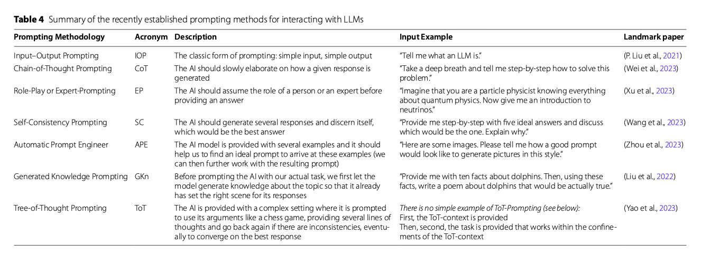
Other Prompting Techniques
Source: Walter (2024, pg. 15)
Notes:
Sources:
Walter, Y. (2024). Embracing the future of artificial intelligence in the classroom: The relevance of AI literacy, prompt engineering, and critical thinking in modern education. International Journal of Educational Technology in Higher Education, 21, Article 15. https://link.springer.com/article/10.1186/s41239-024-00448-3

Slide 24
Prompting Complex Tasks (e.g., Coding)
Successfully accomplishing a complex task like coding requires step-by-step instruction (e.g., numbered lists)
Steps should be sequential
  While multiple aspects can be worked in a single prompt, they may interfere with each other if they are not independent
A single, giant prompt can lead to missed or skipped steps
Be precise and do your research beforehand, e.g.,
  What language do you want to code in?
  What packages do you want to use?

Slide 25
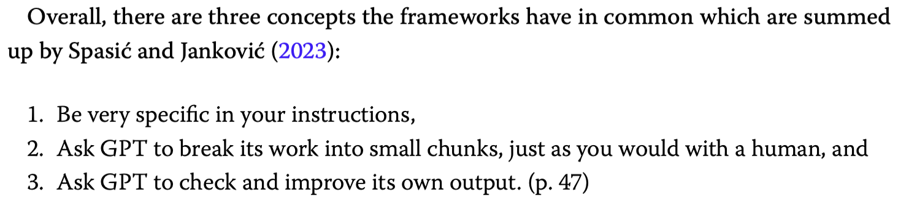
Source: Lee & Palmer (2025, pg. 14)

Slide 26
Planning and Goals
Working with a model to develop a plan (e.g., plan first…no code yet; “talk only”) or to establish goals can help by:
  Breaking down a complex task into smaller steps (e.g., subgoals)
  Providing a contract for you to analyze what the model did – and didn’t – do after the fact
  Allowing for easier tracking of what’s already been done, which also helps understand what comes next
Plans/goals should include things that need to be done and things that shouldn’t be done (i.e., constraints)
Hermes (with a good model) may even ask you to clarify

Slide 27

Auditing, Verification, and GitHub
Never trust anything your agent does
You must review, audit, check, verify
Ask your model to summarize everything it did in the last turn(s) and commit this record to GitHub
Maintaining code on GitHub helps provide context for future work as well as recovery from mistakes/problems (e.g., by reverting commits)
“What’s your trust setting, TARS?
Lower than yours apparently...”
Sources: Acuna, K. (2015, March 31); Nolan, C. (2014)
Notes:
Sources:
Acuna, K. (2015, March 31). The ‘Interstellar’ robot was actually a 200-pound puppet an actor carried on set. Business Insider. https://www.businessinsider.com/interstellar-how-tars-was-built-2015-3
Nolan, C. (Director). (2014). Interstellar [Film]. Paramount Pictures; Warner Bros. Pictures.

Slide 28
Prompting with Hermes Agent

Slide 29
Hermes Agent Commands
Beyond just typing prompts, Hermes provides several commands to help manage more complex tasks, including:
  /prompt – Compose your next prompt in $EDITOR (markdown), then send it (aka /compose)
  /queue – Queue a prompt for the next turn (doesn’t interrupt)
  /steer – Inject a message after the next tool call without interrupting
  /goal – Set a standing goal Hermes works on until achieved
  /subgoal – Add or manage extra criteria on the active goal
  /plan – Write a markdown implementation plan…without executing anything
  /kanban – Multi-profile collaboration board (tasks, links, comments)
The following slides present key summaries from pg. 14 of Lee & Palmer (2025)

Slide 30
Hermes and Projects
To help organize, use the projects feature in the desktop application (see slide notes) or ask Hermes to create a project on the command line interface (CLI)
Make use of Hermes’ context files including:
  HERMES.md – Project instructions (highest priority)
  AGENTS.md – Project instructions, conventions, architecture
  CLAUDE.md – Claude Code context files (also detected)
  SOUL.md – Global personality and tone customization
Notes:
The are several ways to create a new project in the Desktop Application, including the Command Palette: “Cmd+K or Cmd+P (Ctrl+K / Ctrl+P on Windows/Linux)” (type in “project” and pick a folder) – see https://hermes-agent.nousresearch.com/docs/user-guide/desktop#keyboard--navigation
You can also change the view in the Desktop Application to show projects via the döner menu next to ”SESSIONS”; click it and adjust the “Grouping” to “Project”
IDEA.md is also created when creating new Projects via Hermes Desktop

Slide 31
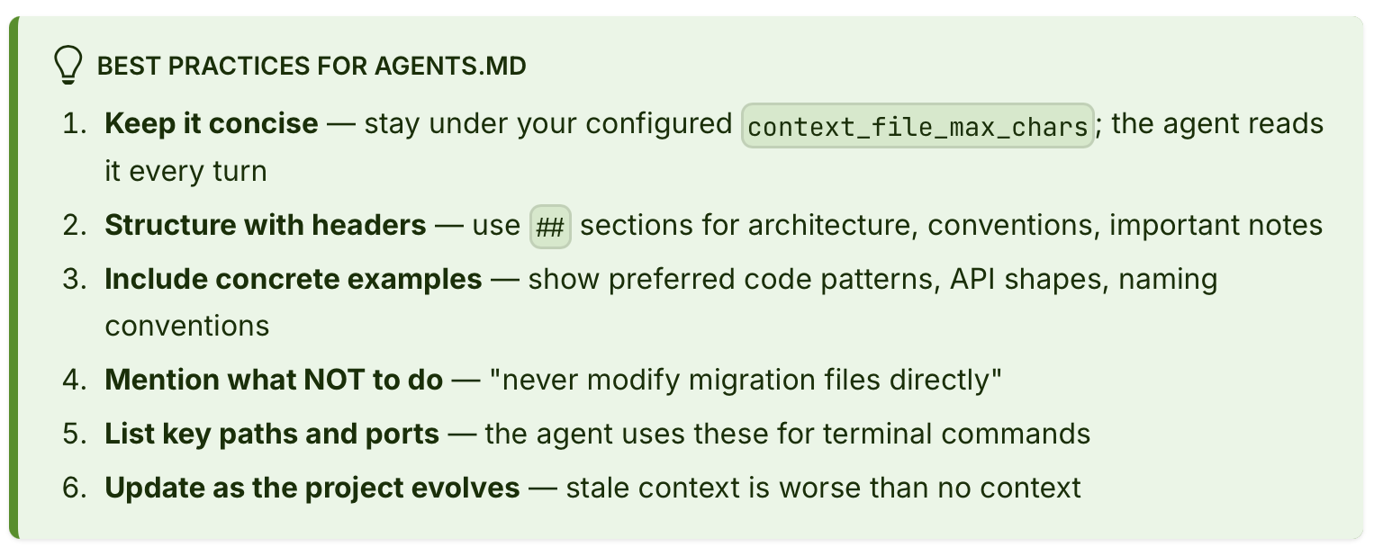
Advice from Hermes’ Docs
Source: Hermes Agent Docs
Notes:
Sources:
https://hermes-agent.nousresearch.com/docs/user-guide/features/context-files

Slide 32
Hermes Learns from and Remembers You
As you use Hermes, it will start making notes about you via persistent memory files, including:
  MEMORY.md – Agent’s personal notes, including environment facts, conventions, things learned
  USER.md – User profile, including your preferences, communication style, expectations
Hermes comes with out-of-the-box skills to help solve tasks, but it can also learn new ones as you work with it (automatically or manually):
  /skills – Search, install, inspect, or manage skills
  /learn – Learn a reusable skill from anything you describe

Slide 33
Class Exercise

